Slide 1

MS-Applied Data Science
Portfolio Milestone
Subbu Kandhaswamy
ID - 743189972
NetID - SKANDHAS
Git Repo: https://github.com/subbukandhaswamy/IST782-MSADS
Google drive : https://drive.google.com/drive/folders/1hrhs_qrq-07ghDqtCAC2Pc0IAKQMo3rK?usp=sharing

Slide 2

Introduction to ADS?
Applied Data science program in Syracuse enables students to apply appropriate analytical and computational methods to handle real-world problems effectively.
Understanding the data, enhances clarity and communicate technical information to targeted audience thru great visualization.
Methods to collect, analyze and develop insights using data from multitude of domains using various tools and techniques.
The projects and presentations exemplifies the skills that we developed through this program, and I will be covering a subset of courses (below) as part of this portfolio milestone presentation
IST 659 – DATABASE ADMIN CONCEPTS AND DB MANAGEMENT
IST 722 – DATA WAREHOUSING
IST 651 – SCRIPTING FOR DATA ANALYTICS
IST 718 – BIG DATA ANALYTICS

Slide 3
Key Learning Objectives
Broad overview of the major practice areas in data science
Collect and organize data.
Identify patterns in data using visualization techniques, statistical analysis, and data mining process.
Develop alternative strategies based on the data.
Build plan of action to implement the business decisions derived from the analyses.
Demonstrate communication skills regarding data and its analysis for managers, IT professionals, programmers, statisticians, and other relevant professionals in their organization
Synthesize the ethical dimensions of data science practice.

Slide 4
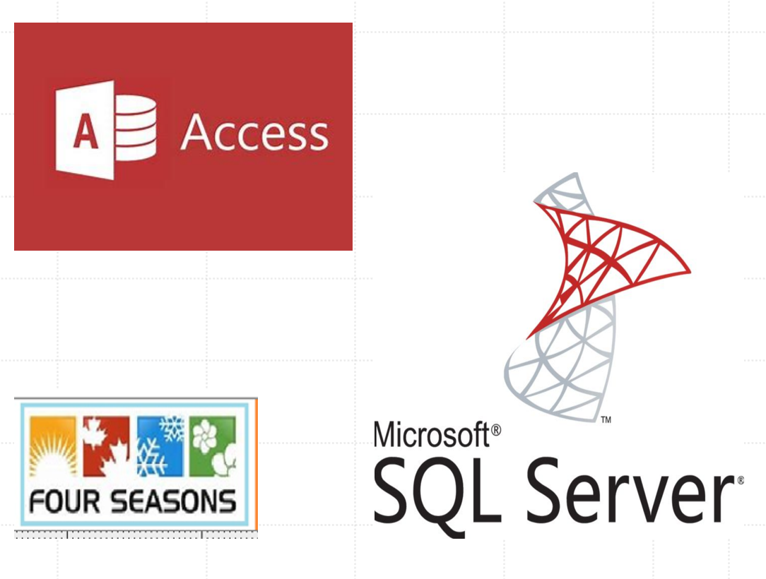
IST 659 DATABASE ADMINISTRATION 4SEASONS
Prof: Chad Harper

Slide 5
Data Administration for 4 seasons
Identified the requirement to design and implement appropriate data-oriented solutions using the relational data storage model.
Applied normalization techniques to improve the database schema, Created database objects (tables/columns) to meet business requirement and queries for CRUD operations using TSQL.
Performance and data integrity improvements to handle rapid data growth and latency.
The solution enabled Four Seasons their following business operations efficiently-
Inventory
Sales
Customers
Orders

Slide 6
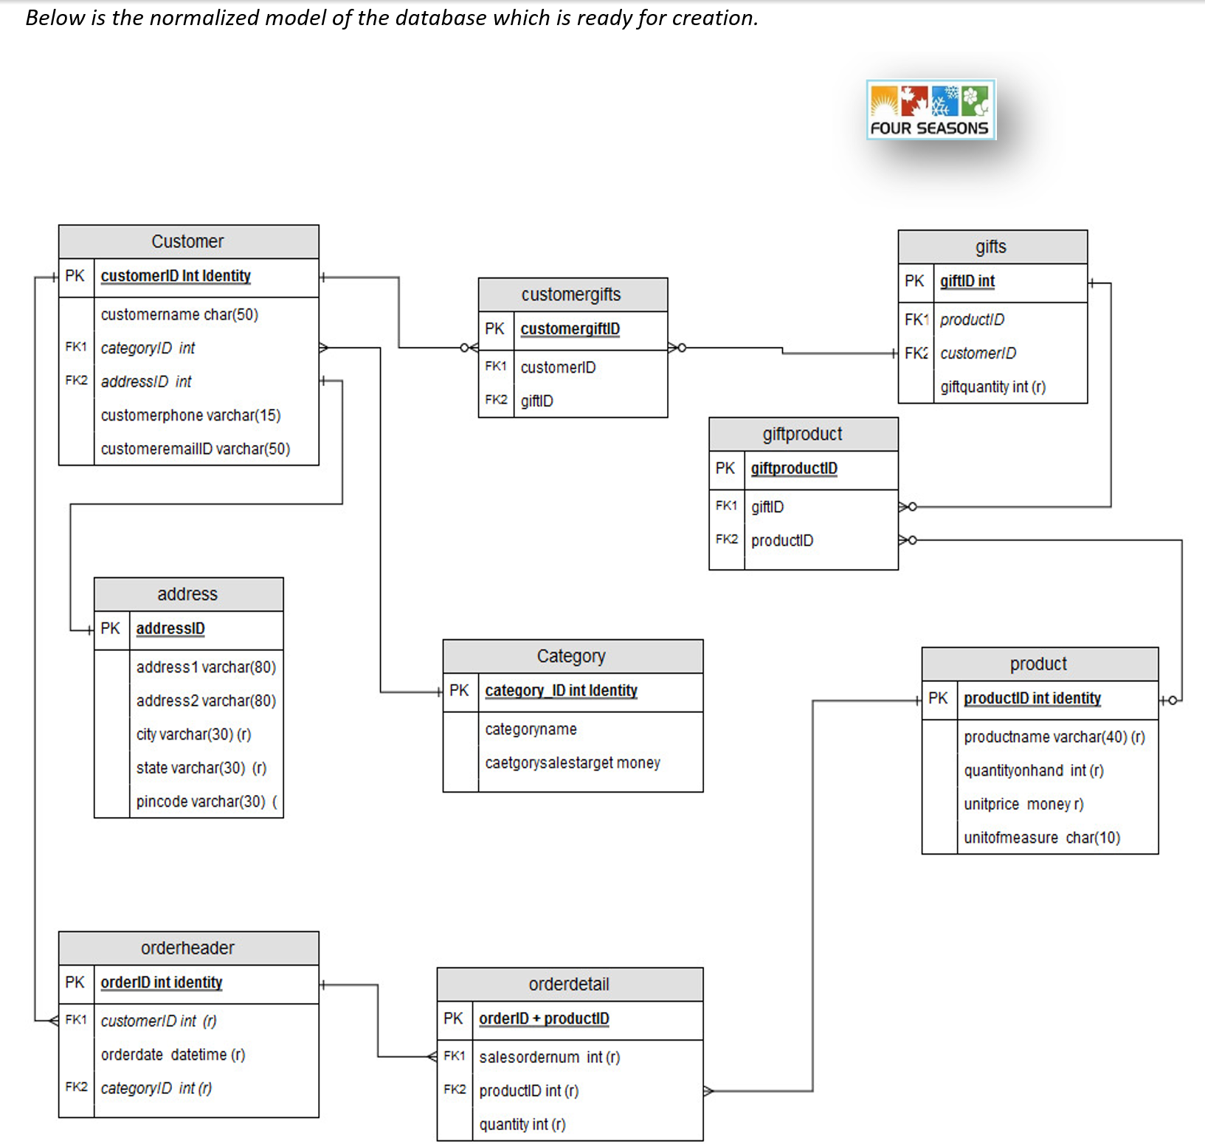
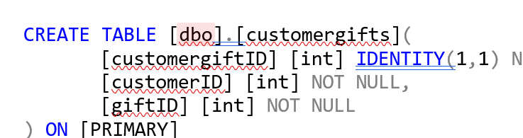
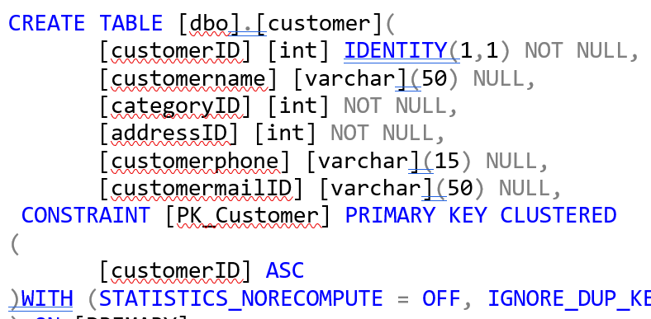
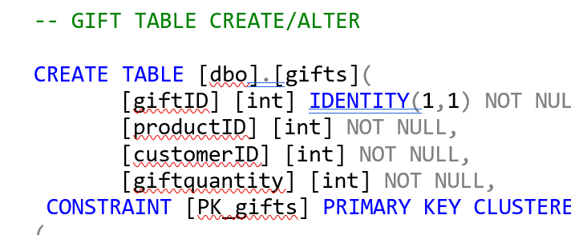
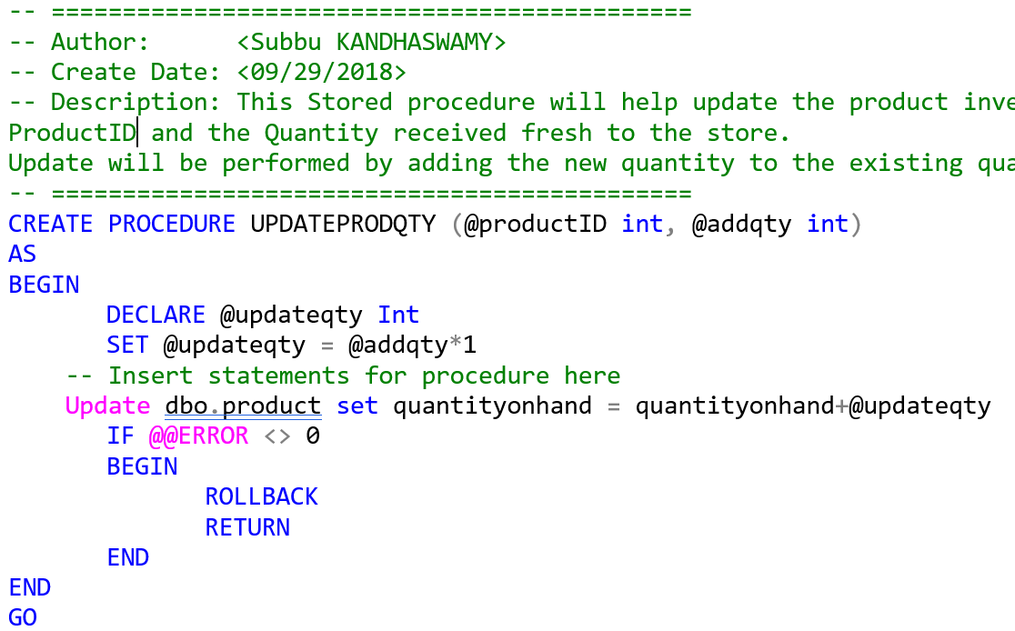
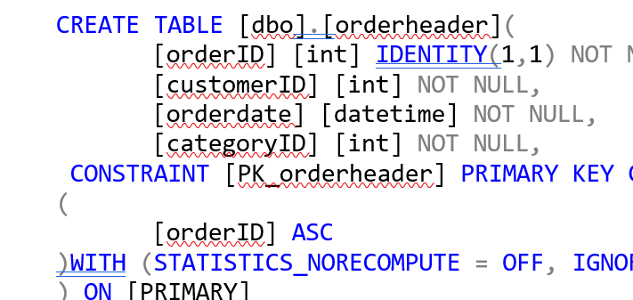
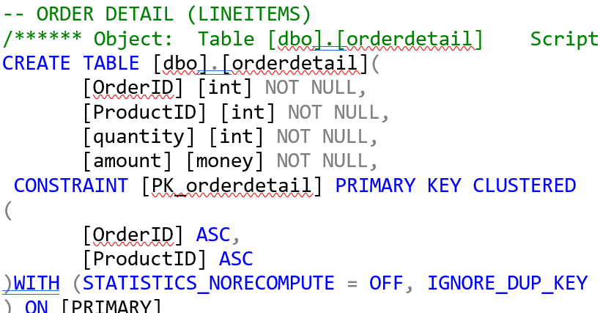
Data Administration for 4 seasons

Slide 7
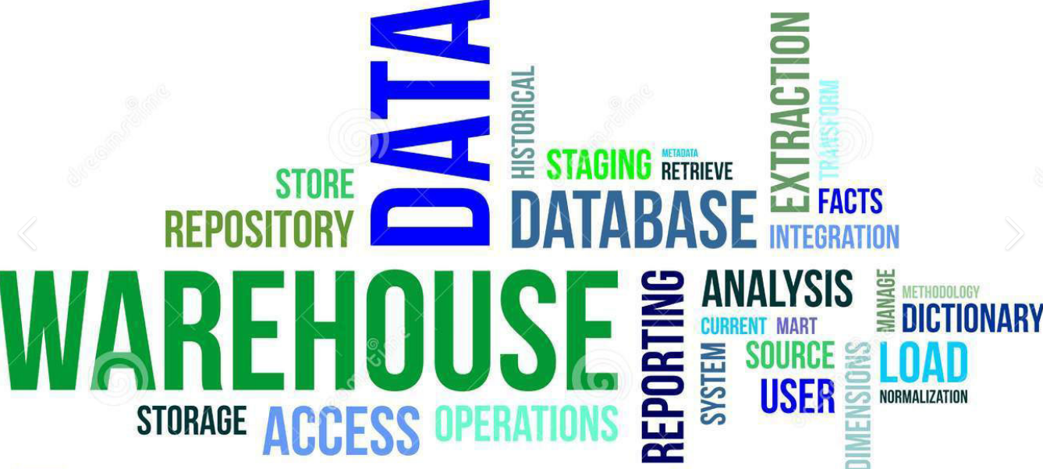
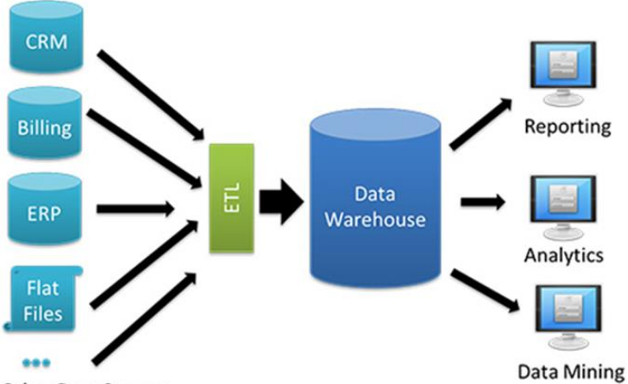
IST 722 - DATA WAREHOUSE & BI SOLUTION Fudgemart
Prof: Humayun Khan
Notes:
Understanding ODS, Data Warehouse, Data Mart
Components of a data warehouse
Differentiate between Ralf Kimball’s and Bill Inman's approaches
Various integration approaches - ETL, EII, EAI
Design and implement data warehouse and business intelligence components
Define the roles and responsibilities in the design and development of data warehouses
Differentiate various requirements gathering and dimensional modeling techniques

Slide 8
Data Processing & Solution Plan for Fudgemart Inc
Identifying OLTP data sources to move into staging bucket. One or more sources depending on how and where transaction data are captured.
Model & Refine the data (Extract , Transform and Load the data for reporting)
Build Analytical Reports focusing Sales & Customer Satisfaction using BI platform (Power BI)
Enable Fudgemart Inc to Review, Plan and make Decisions for business growth using aggregated sales trends by region, product, category and periods

Slide 9
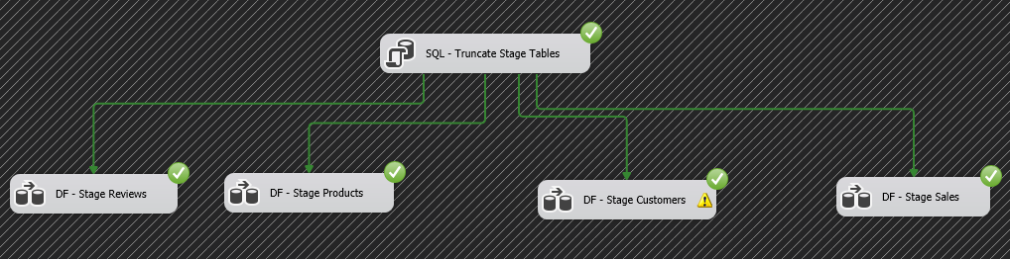
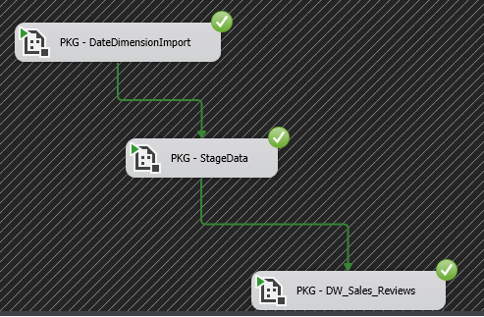
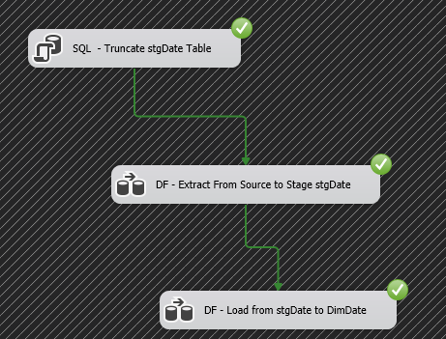
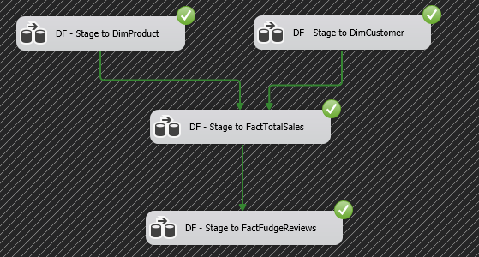
ETL – Extract / Process /Load data
Stage
ETL packages execution
Date Import execution
DW Import execution

Slide 10
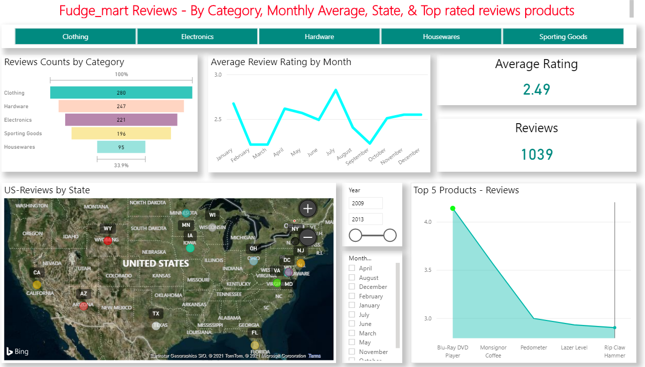
Business Intelligence – Product Reviews

Slide 11
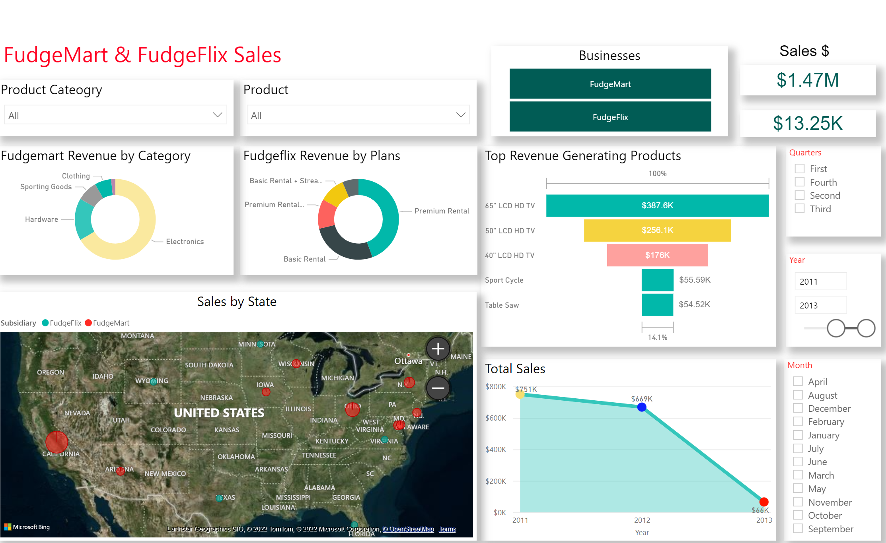
FudgeMart/FudgeFlix–Combined Sales analysis

Slide 12
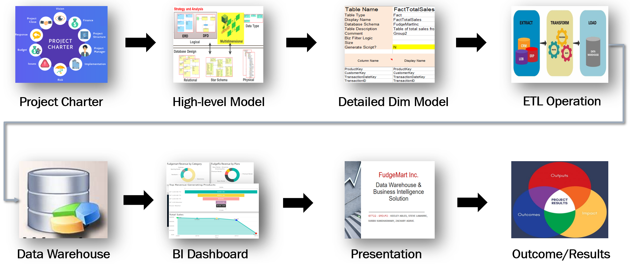
Fudgemart - Data Warehouse & BI

Slide 13
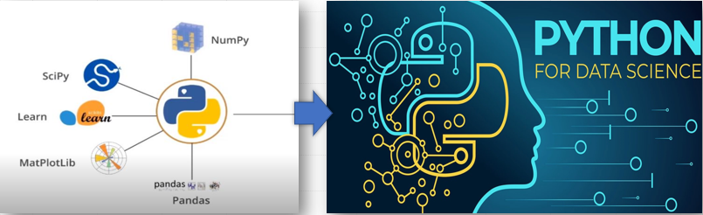
IST 652 – Scripting Data Analytics
Dr. Deborah Landowski

Slide 14
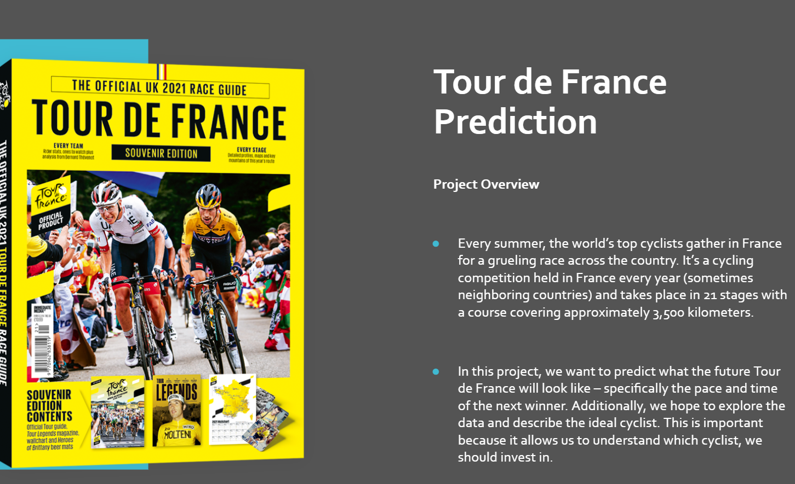

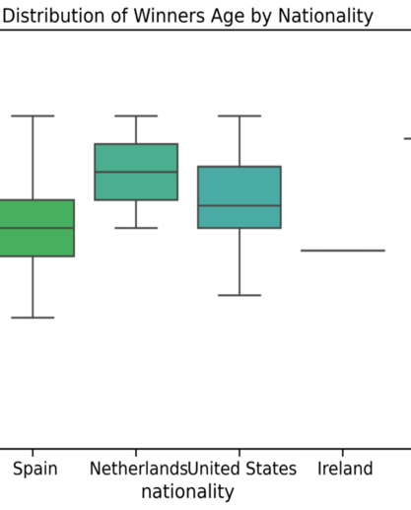
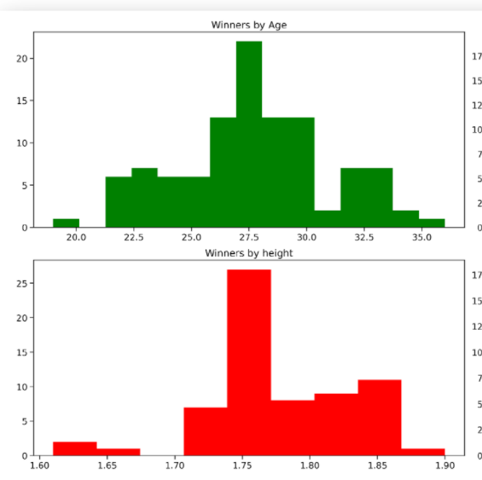
IST 718 – BIG DATA ANALYTICS Tour De France
Dr. Jonathan Fox
Notes:
Translate a business challenge into an analytics challenge.
Use linear and logistic regression, decision trees, and neural networks to make predictions.
Use data science to gain actionable insights.
Use Python and Apache Spark to build big data analytics pipelines.
Learn classic and state of the art machine learning techniques.
Explain how advanced analytics can be leveraged to create a competitive advantage.

Slide 15
Analyzing Big Data
Translate a business challenge into an analytics challenge.
Analyze big data, create statistical models, and identify insights that can lead to actionable results.
Use Python and Spark to build big data analytics pipelines.
Learn classic and state of the art machine learning techniques
Explain how advanced analytics can be leveraged to create competitive advantage;

Slide 16
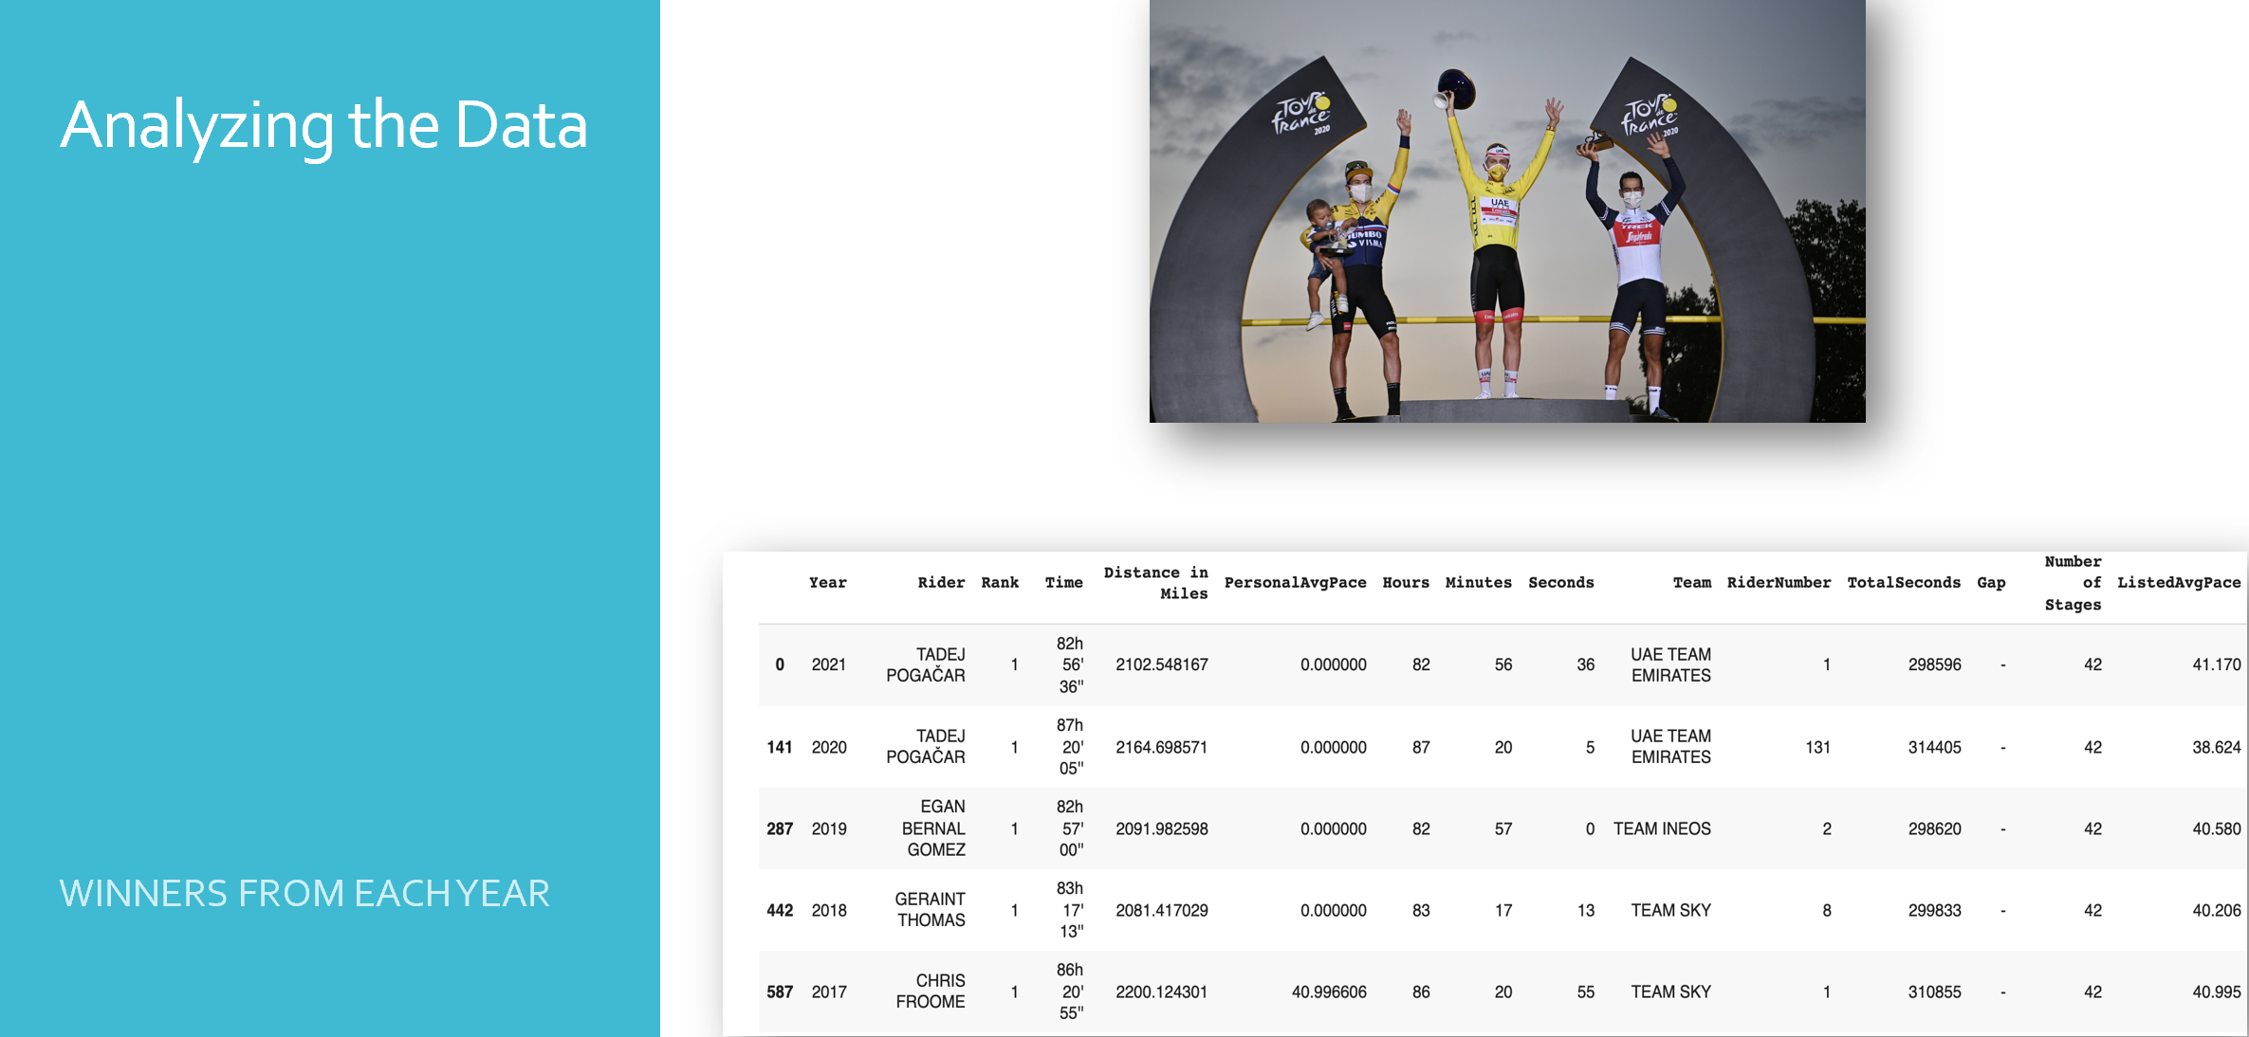
Tour de France

Slide 17
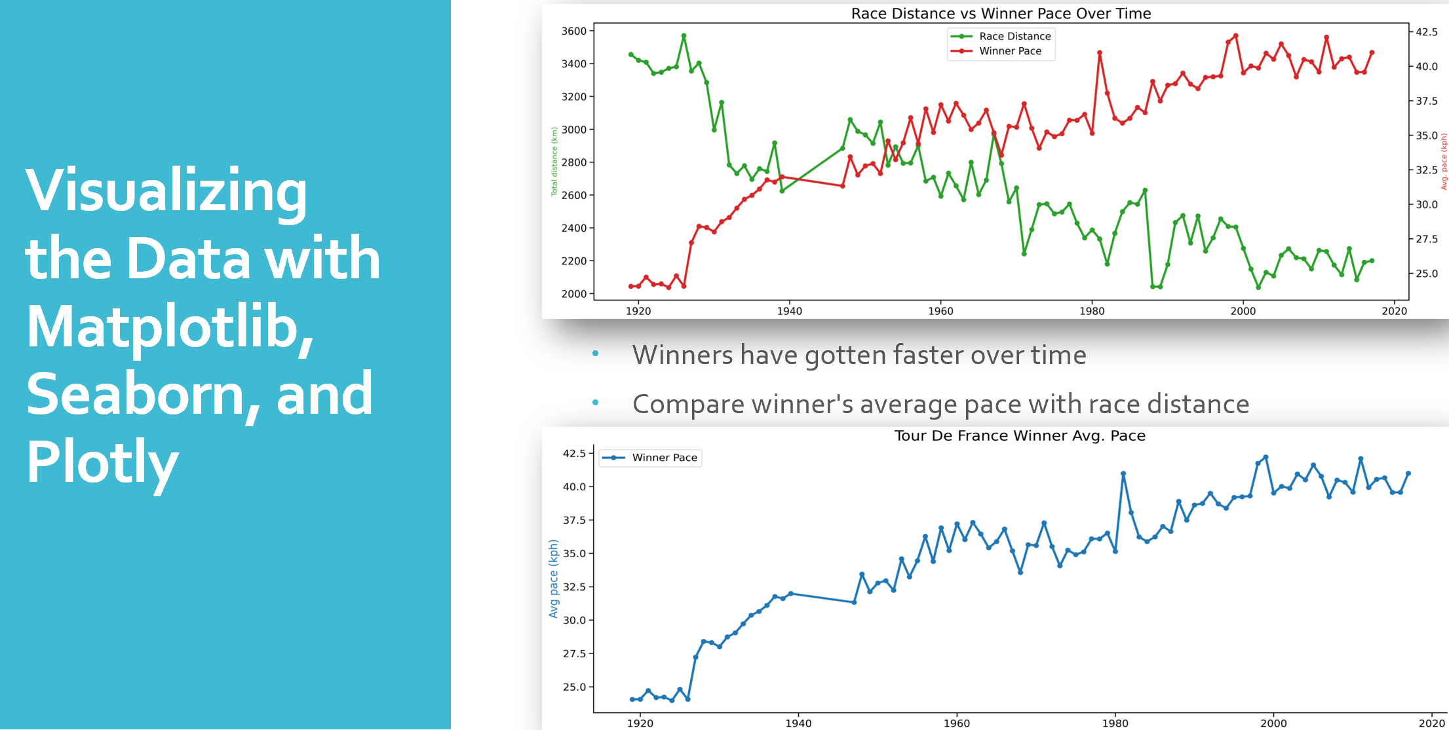
Tour de France analysis

Slide 18
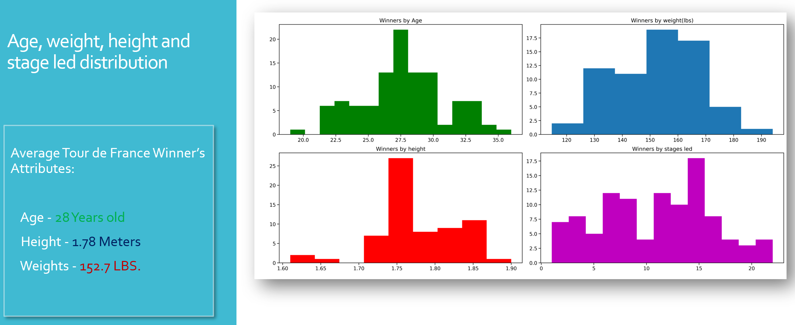
TDF Winner’s attributes

Slide 19
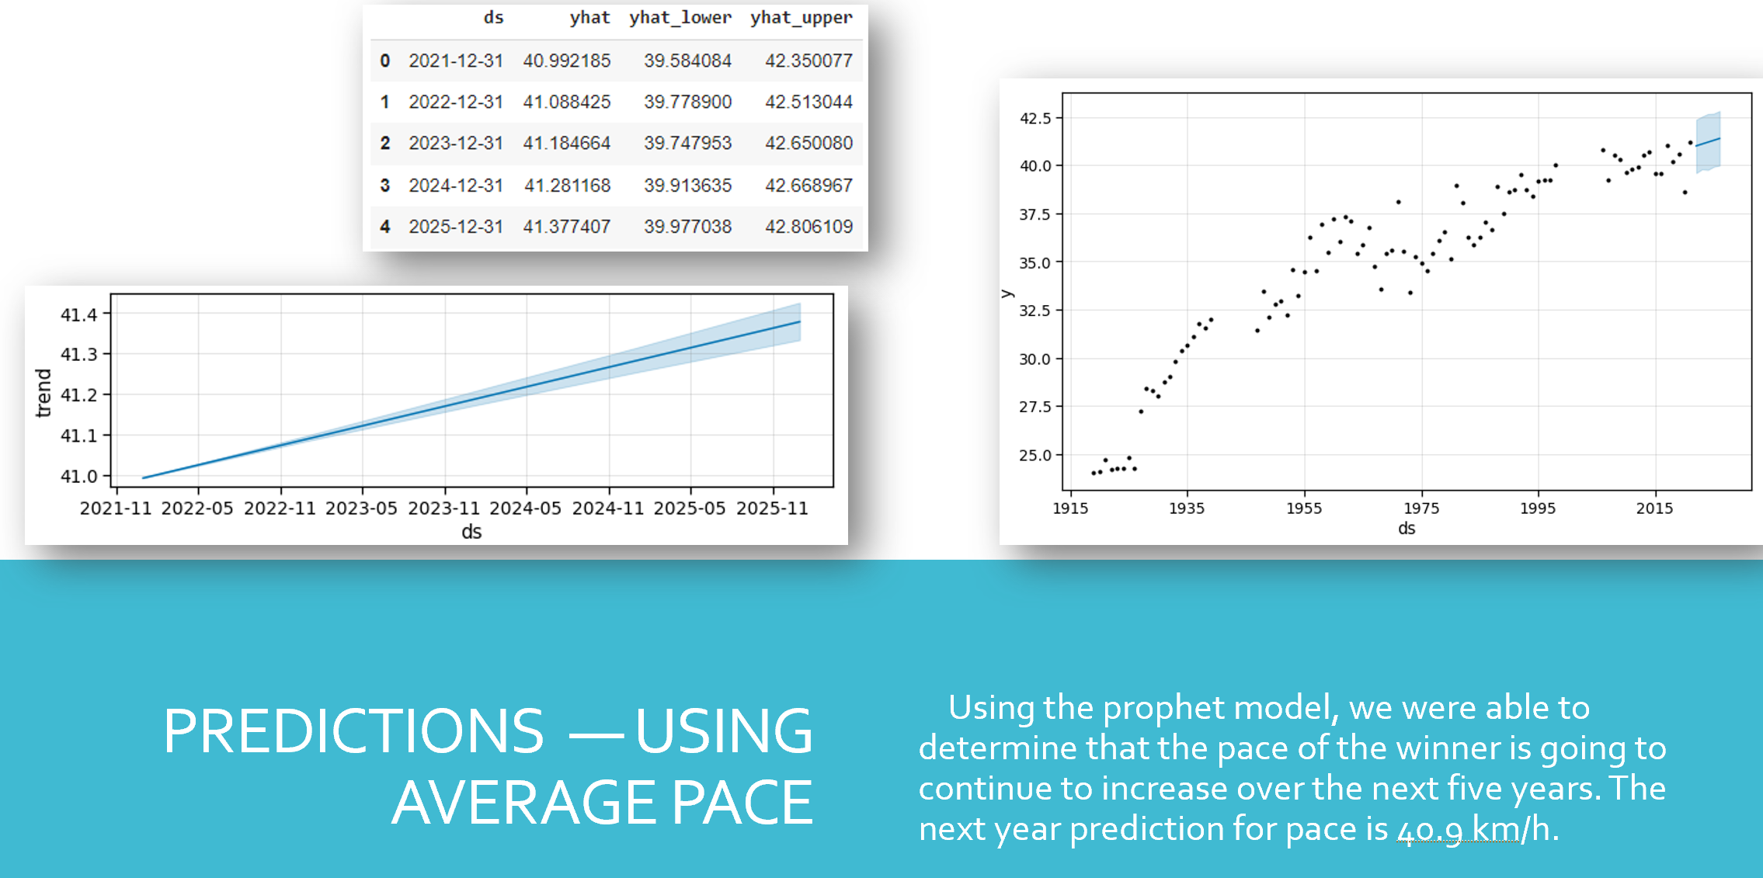
Predictive analysis

Slide 20
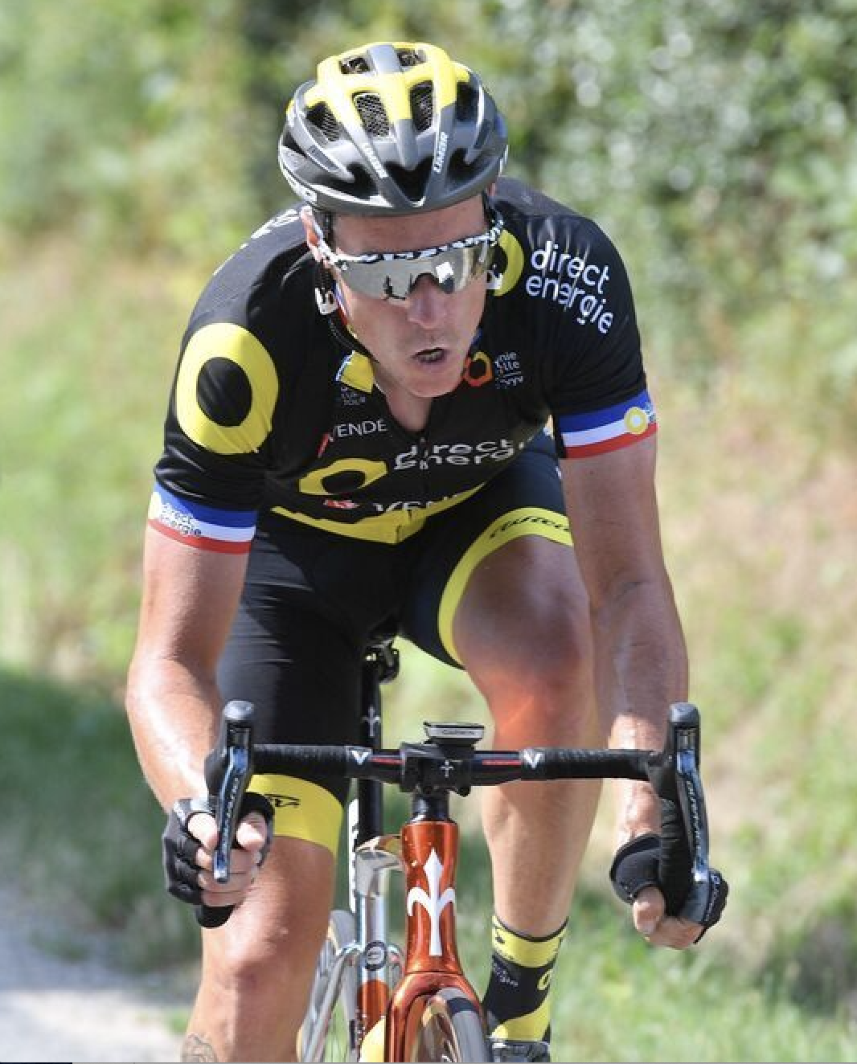
Tour De France – Prediction results
Winners of Tour de France will win by continuing to beat the previous years' winner's paces and times
Winners of Tour de France will likely be around 28 years old, 1.78 meters tall, and around 153 pounds

Slide 21
Conclusion
The courses covered in this portfolio milestone deck, helped me to understand various forms of data, gave clarity to apply the methods and analyze data to present the insights and predict future outcomes that I can share to make business decisions and handle real-world problems.
With other courses of my Applied Data Science curriculum that includes
Data Science introduction
Data Analysis & Decision making
Data & Business Analytics
Management Service Principles
Cloud Management &
Information policy.
helped me gain the critical knowledge around cloud solutions, security & privacy, machine learning, mining and business/management science techniques.

Slide 22
Thank You! to all my Professors and fellow classmates for sharing knowledge & for the great experience during my courses

